Slide 1


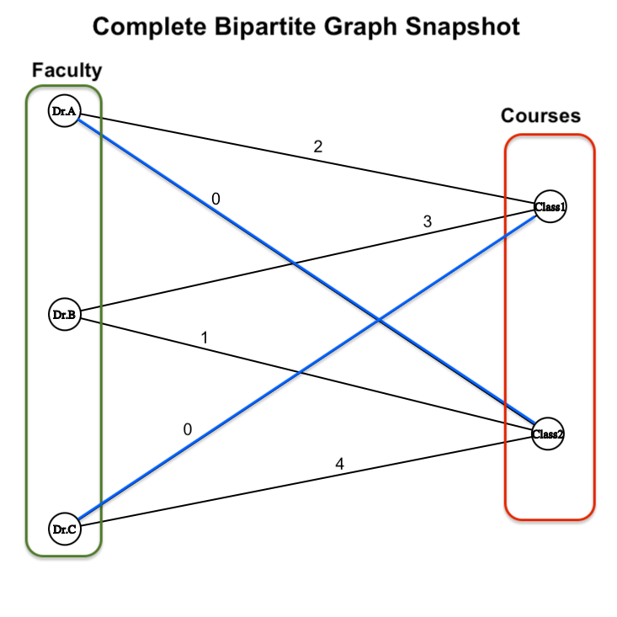
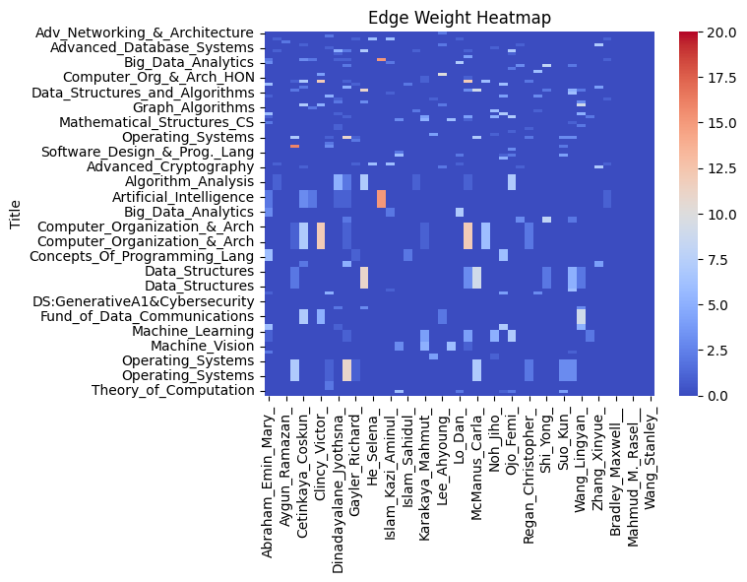
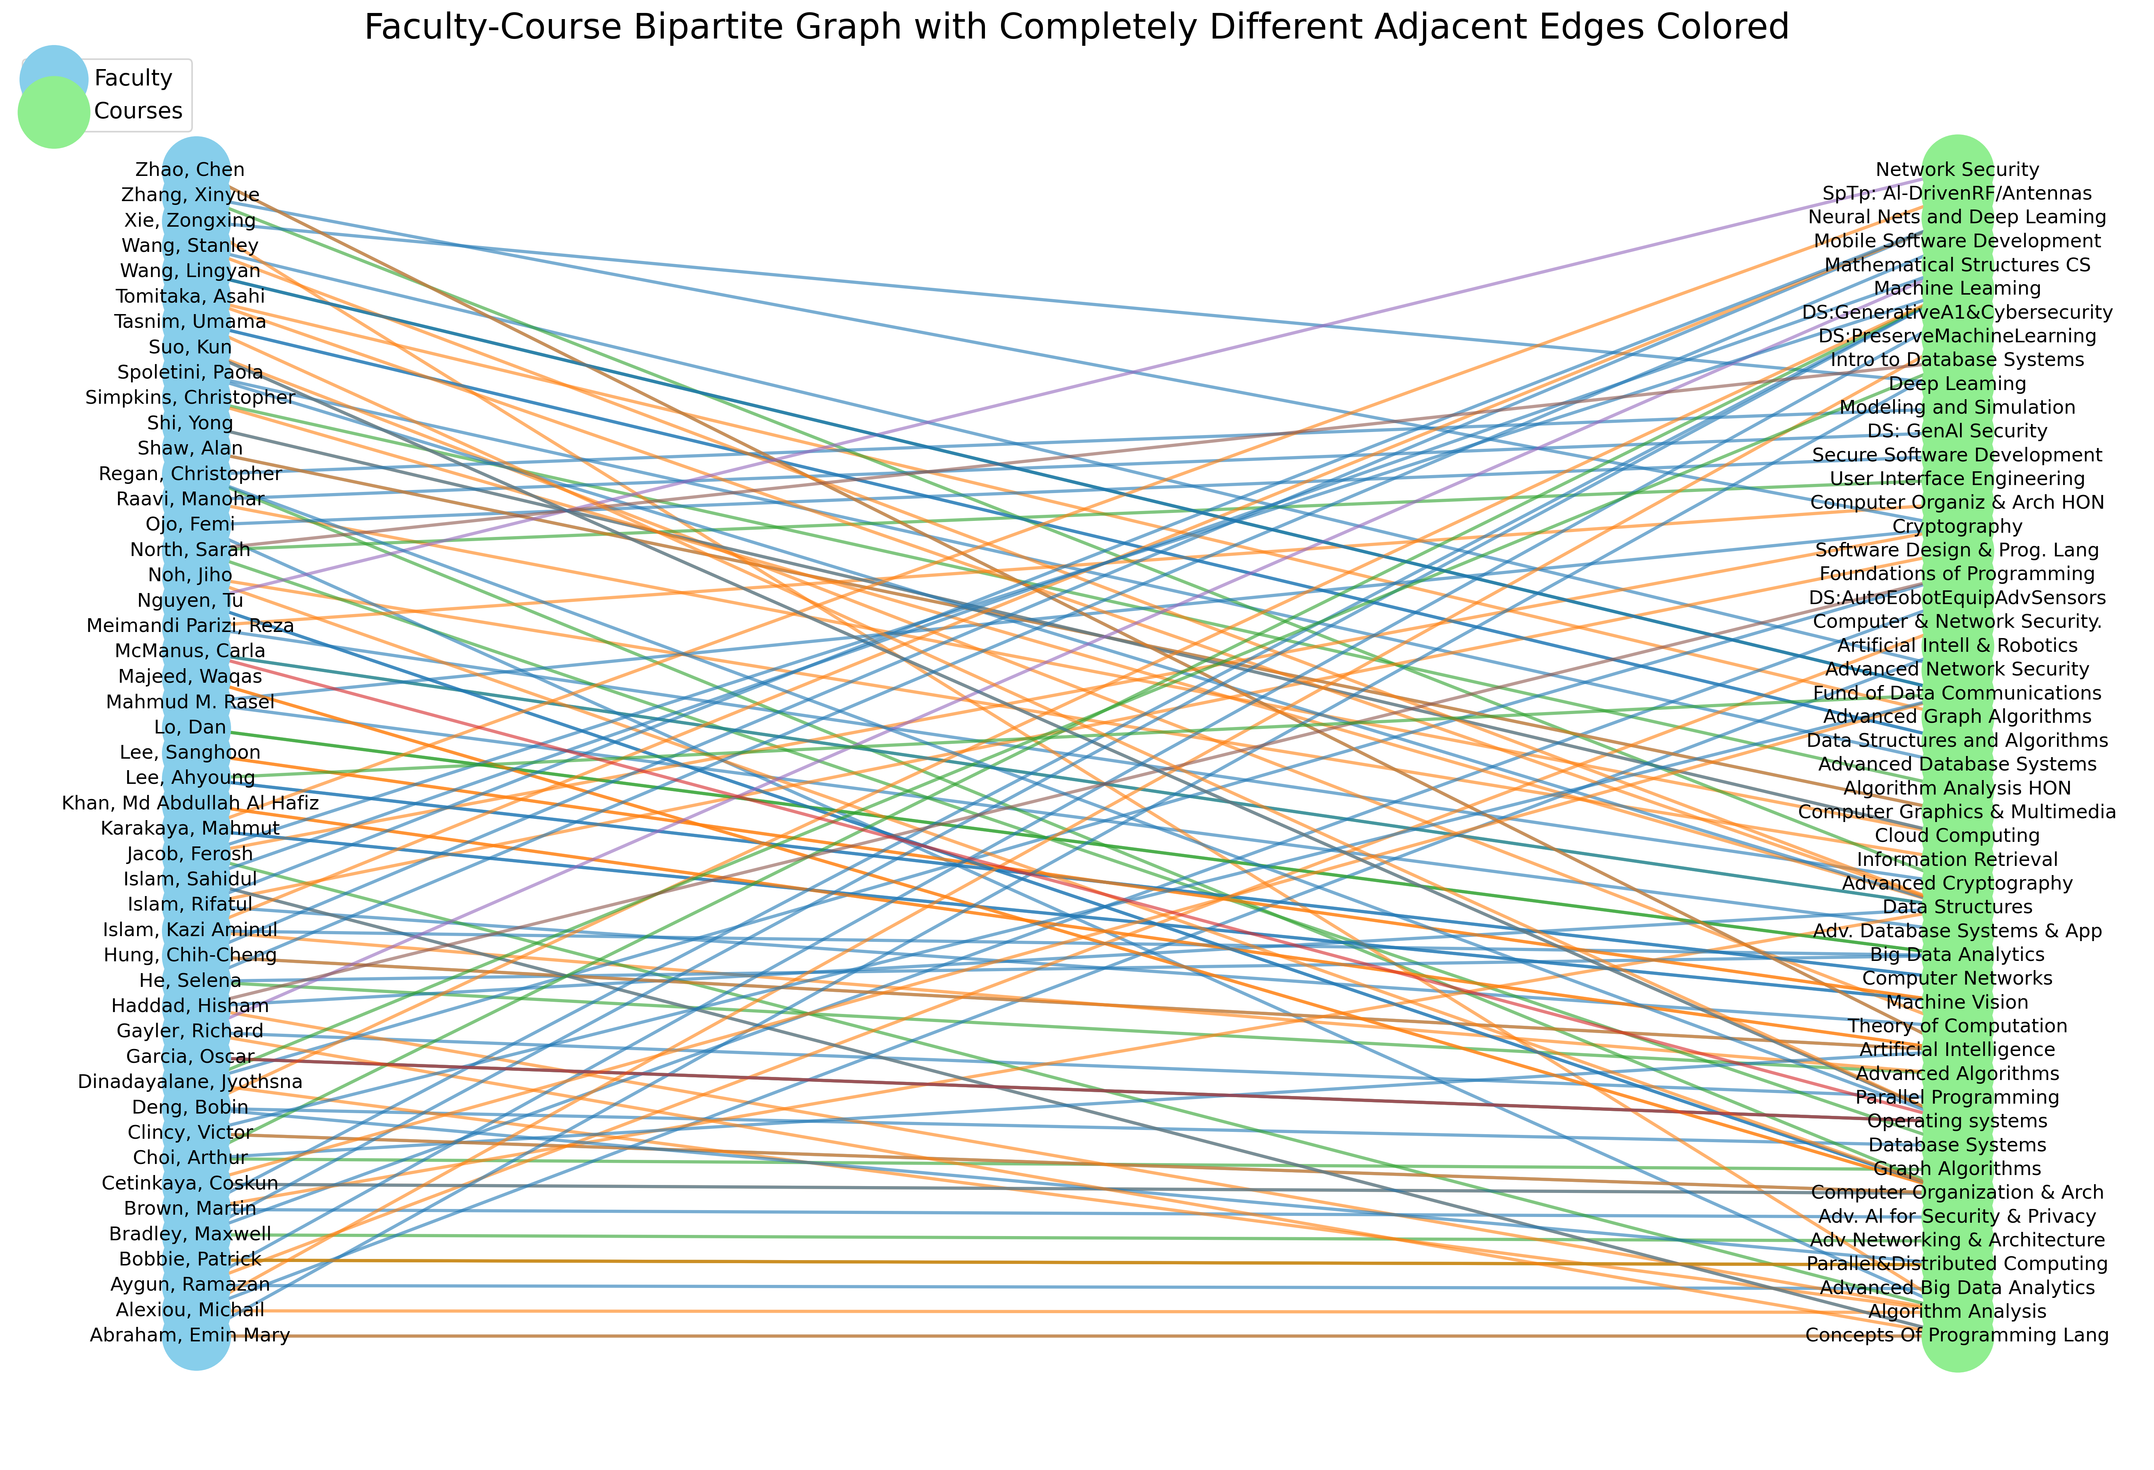
Matching Algorithm for More Effective Class-Faculty Pairings
Liz Ragsdale – May 2025 & Ramya Madhuri Narapureddy – December 2026 with Dr. Joseph DeMaio
INTRODUCTION
RESULTS
Assigning faculty to courses is a crucial part of academic planning, as both parts are needed to run a class. However, other factors limit the pairings, such as faculty workloads, and changes in student population affecting the number of needed courses, which makes forming a cohesive schedule more difficult. Faculty availability and course demands change from semester to semester, creating problems for anyone hoping they could just use last semesters schedule. Using graph theory, this project aimed to create a scheduling solution that utilizes past schedule data to algorithmically assign faculty to courses with the goal of offering a solution that could improve scheduling efficiency and reduce manual effort when making scheduling decisions.
The output of the algorithm resulted in 123 course section assignments across 41 faculty members in the KSU School of Computer Science.
The total weight of the matching graph is 686 total semesters of experience.
The experience score had a mean of 5.6 semesters of experience.
Experience score has standard deviation of 5.5.
36 out of the 123 pairings had an experience level of 0.
METHODS
Our dataset for the project used the Kennesaw State University school of computer science as the sample group. Using course and faculty information from the past 3 years to form a dataset of each professor’s past teaching history and the number of times they taught each course. This data was assembled alongside lists of the Spring 2025 course offerings and computer science faculty teaching at least one course for the semester. Courses not offered and past faculty who are not available in spring 2025 were filtered out while any faculty or courses that were new were included, but had no prior experience listed.
Data in graph theory is conveyed mainly by edges which connect nodes and together form graphs. A bipartite graph occurs when the nodes are sorted into two subsets that do not have edges within each subset, like faculty and courses. These graphs are referred to as complete when there is an edge to every possible pairing of nodes. Edges can also be weighted to indicate the value of an edge. In our data this is represented as a faculty’s past teaching experience with a course. The prior semester data used was to create a complete bipartite weighted graph, as every professor of computer science is capable of teaching any course, but their past experience differs.
Faculty to course assignment is done through creation of a maximum matching, which ensured every course had a match. To fit our data for this purpose, each section of a class offered became a different node in the course subset with identical weights to other sections. Additionally, professors teach multiple classes a semester, which resulted in each professor being listed 3 times within the graph to be assigned to multiple courses. We used a linear sum assignment algorithm, which considered the edge weights and produced an output where the maximum possible teaching experience is being taken advantage of from the possible pairings.
Figure 1: a small-scale snapshot of a weighted complete bipartite graph within the context of the data.
Figure 2: A heatmap of the relationship between faculty and courses through prior teaching experience.
DISCUSSION
The linear sum algorithm did successfully create a feasible set of professor-to-course pairings while accounting for varying number of sections offering in course and faculty experience within courses. In considering that experience, over 70% of courses are paired with faculty who have prior experience teaching the class, but this algorithm can lead to the trend of new faculty consistently being paired to new course offerings.
This matching is flawed in that it only accounted for past experience, which isn’t the only factor universities might wish to consider, and it also assumed that every faculty member was to teach the same number of courses. In reality the number of courses a professor teaches varies individual based on other reasons. However, these flaws could be fixed in future iterations through creating a more complex method of determining weights to account for other factors. Faculty availability could also be considered similarly to how course sections were, allowing for variation from professor to professor.
REFERENCES
Bipartite matching & Hungarian Algorithm:
https://www.columbia.edu/~cs2035/courses/ieor6614.S16/GolinAssignmentNotes.pdf
Data sourced from Kennesaw State University Department of Computer Science within the College of Computing and Software Engineering
Figure 3: Maximum matching graph of each course section to a faculty member, with each faculty member teaching a maximum of 3 courses.

